Slide 1
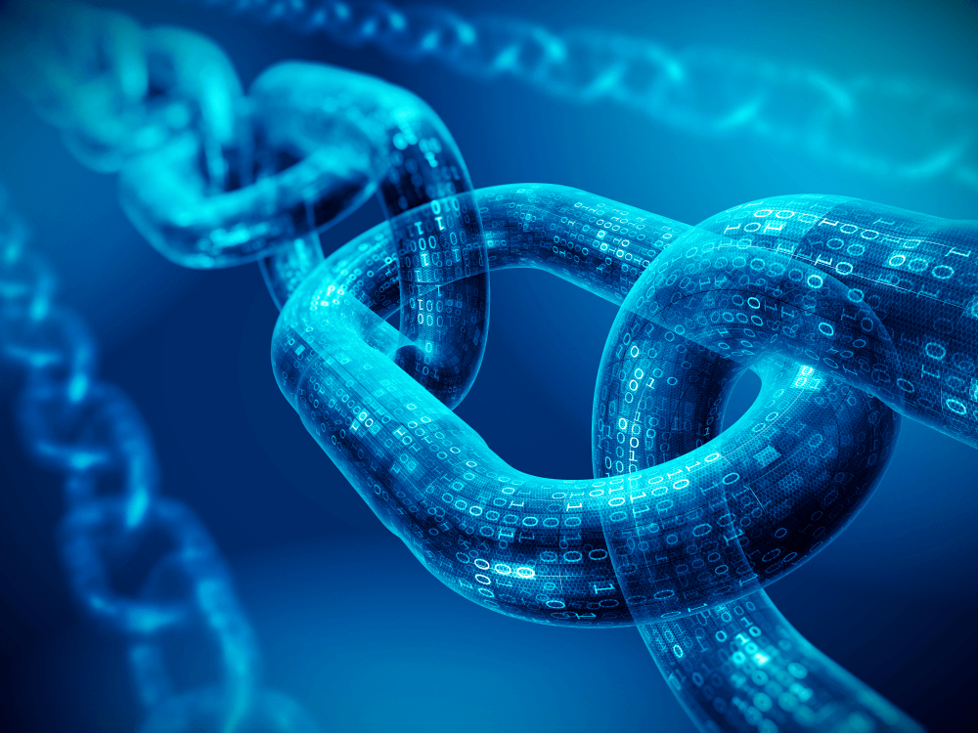
RISE
Isidro, Sam, Eric, and Ricky

Slide 2
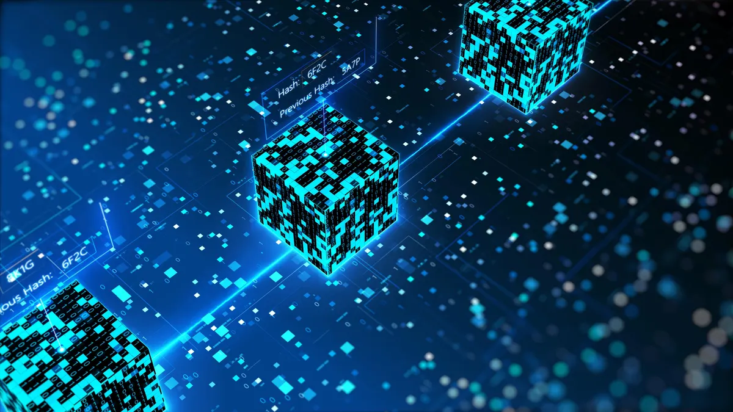
Executive Summary
Primary Objective: Develop an intuitive NFT marketplace on the blockchain, featuring a minting engine for seamless NFT tokenization, ownership, and management. Through the RISE marketplace, registered users can securely list, buy, sell, and transfer their digital assets. Additionally, we went beyond the norm by creating our own exclusive NFTs using advanced AI algorithms, offering unique and visually stunning images. These proprietary NFTs serve as both a proof-of-concept and a demonstration of our platform's capabilities, alongside providing a dynamic portfolio that enhances user interaction and exemplifies the potential of our technology. This approach validates our smart contracts' efficiency and showcases the versatility of our platform.

Slide 3

Problem: Lack of Accessibility and Limited Trust and Security
Solution:
RISE revolutionizes digital asset trading for all, regardless of tech skill. With a user-friendly interface and blockchain, our marketplace ensures secure, transparent transactions. Smart contracts boost trust, reducing fraud worries. Beyond accessibility, it's a creator's haven, amplifying exposure and monetization possibilities.

Slide 4
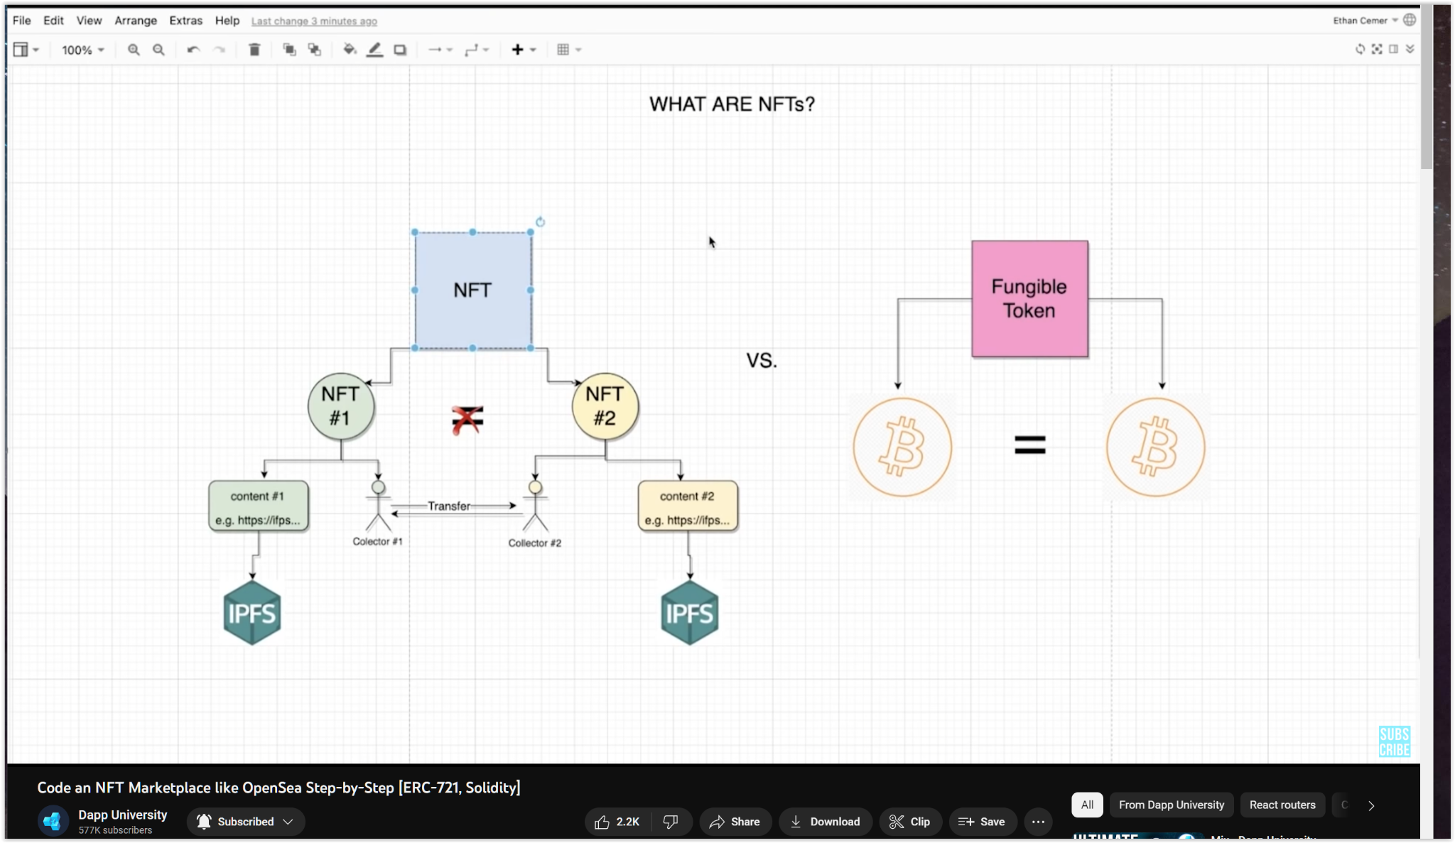
What is a Non-Fungible Token (NFT)
A Non-Fungible Token (NFT) is a unique digital asset verified using blockchain technology. Unlike standard tokens that are interchangeable with each other, each NFT has a specific code and metadata that make it one-of-a-kind.

Slide 5
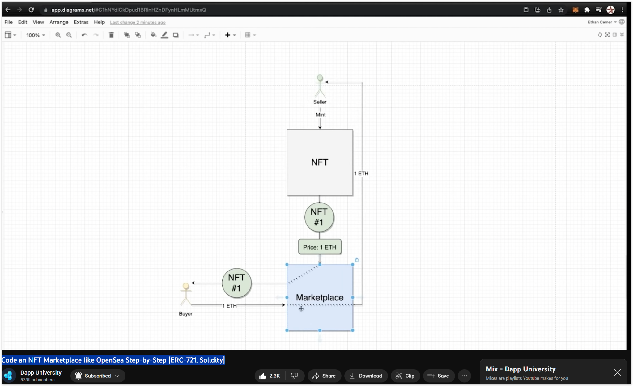
The Process of Minting a Non-Fungible Token (NFT)

Slide 6
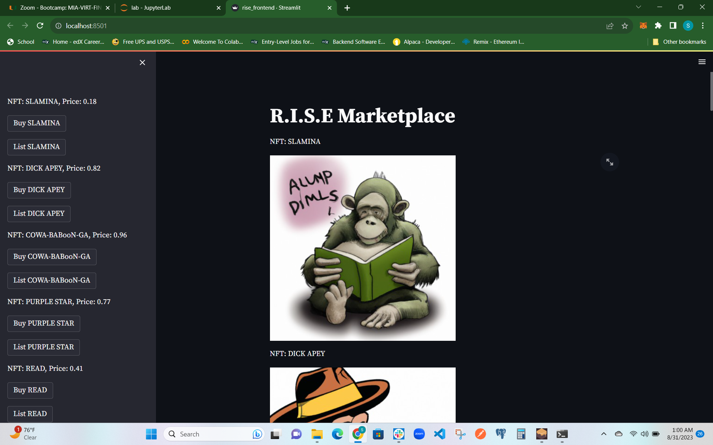
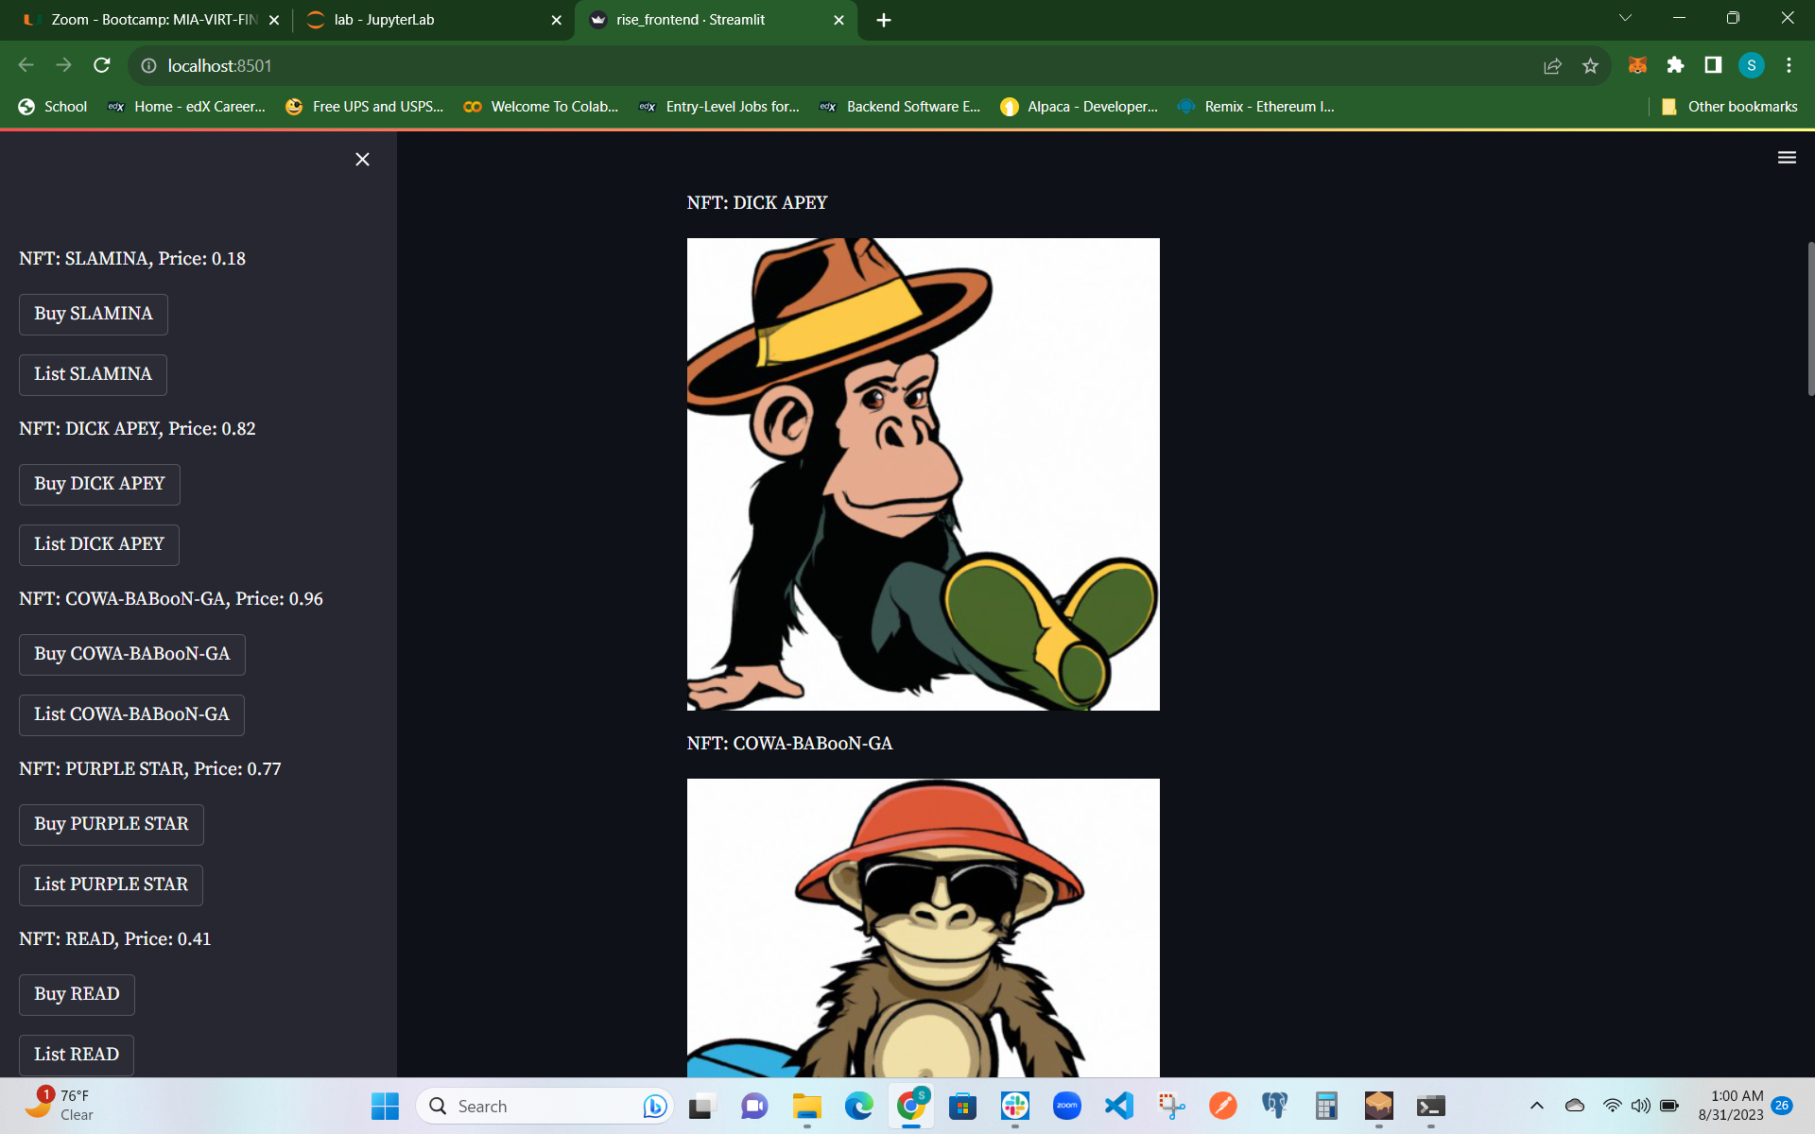
Demo

Slide 7
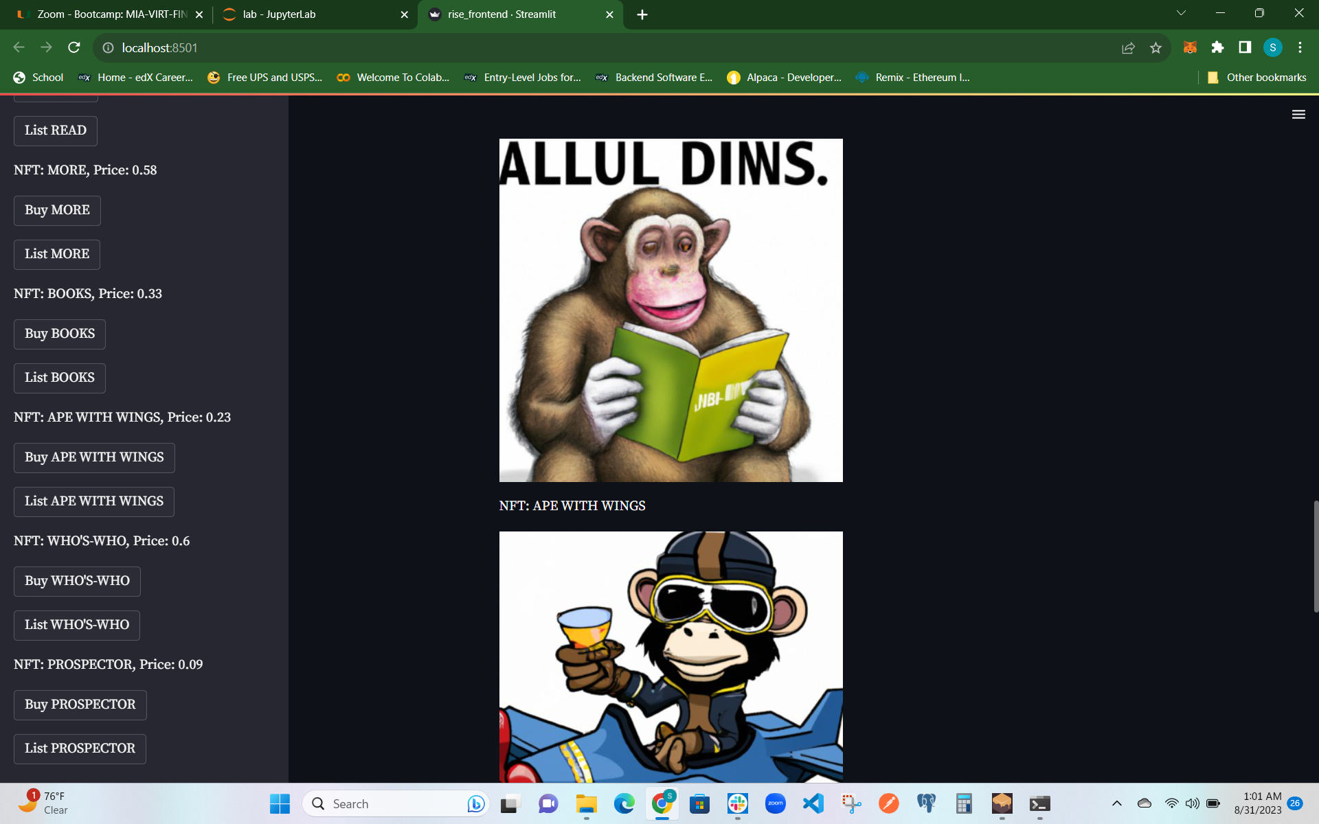
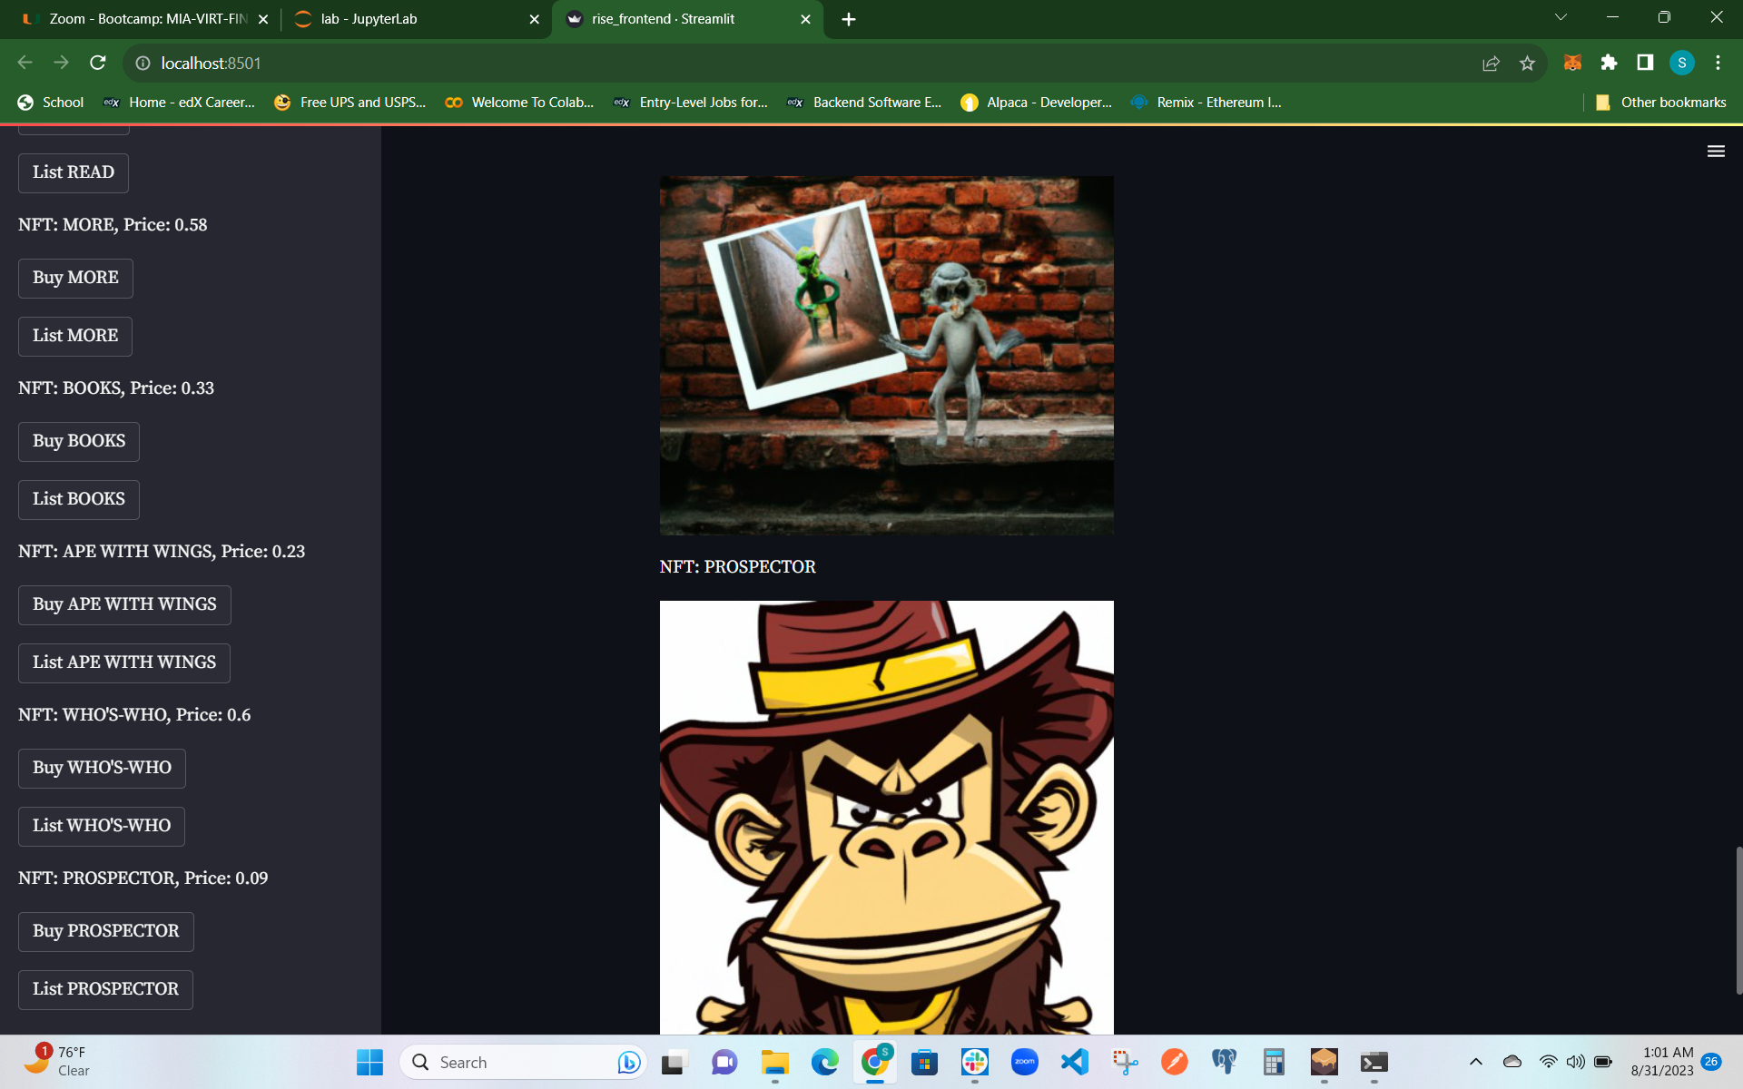
Demo

Slide 8
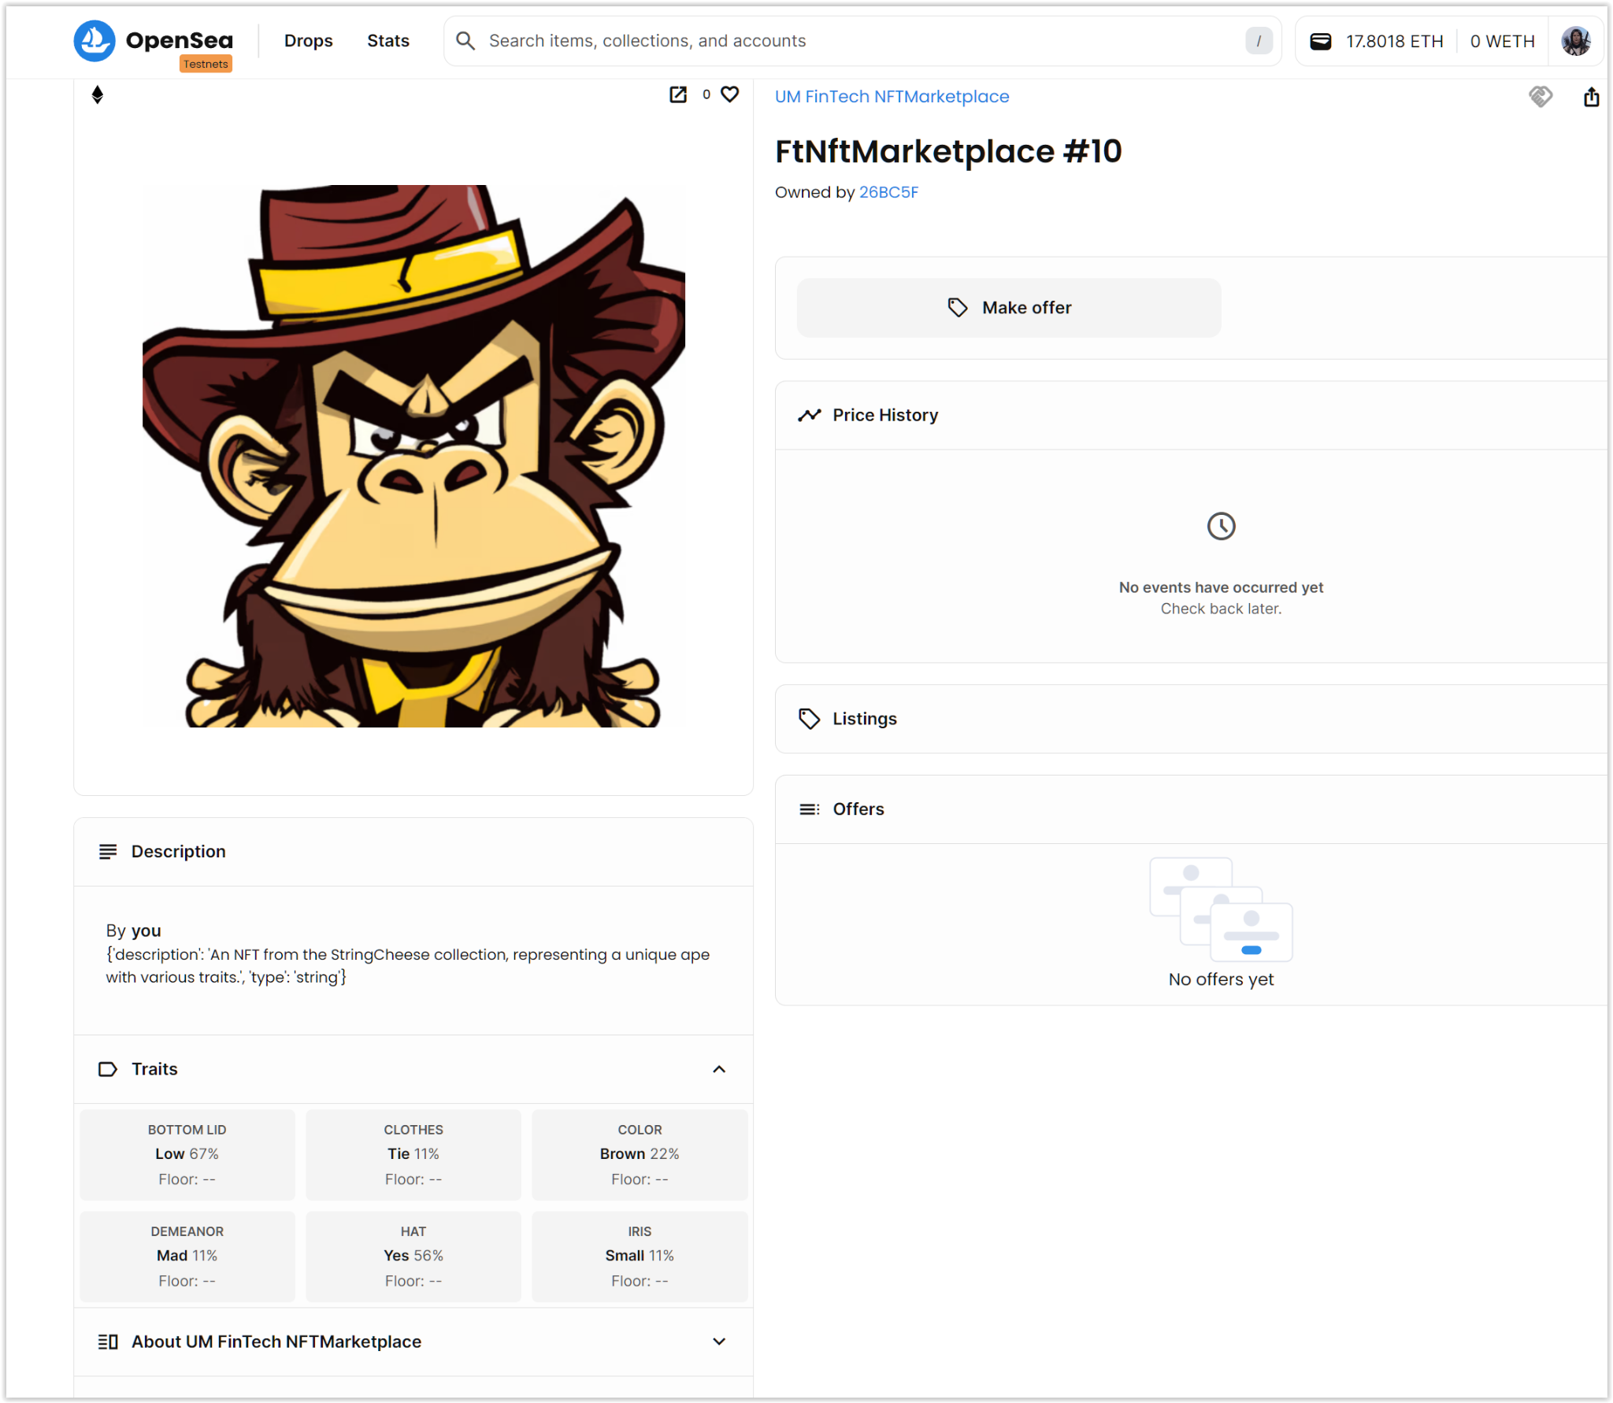
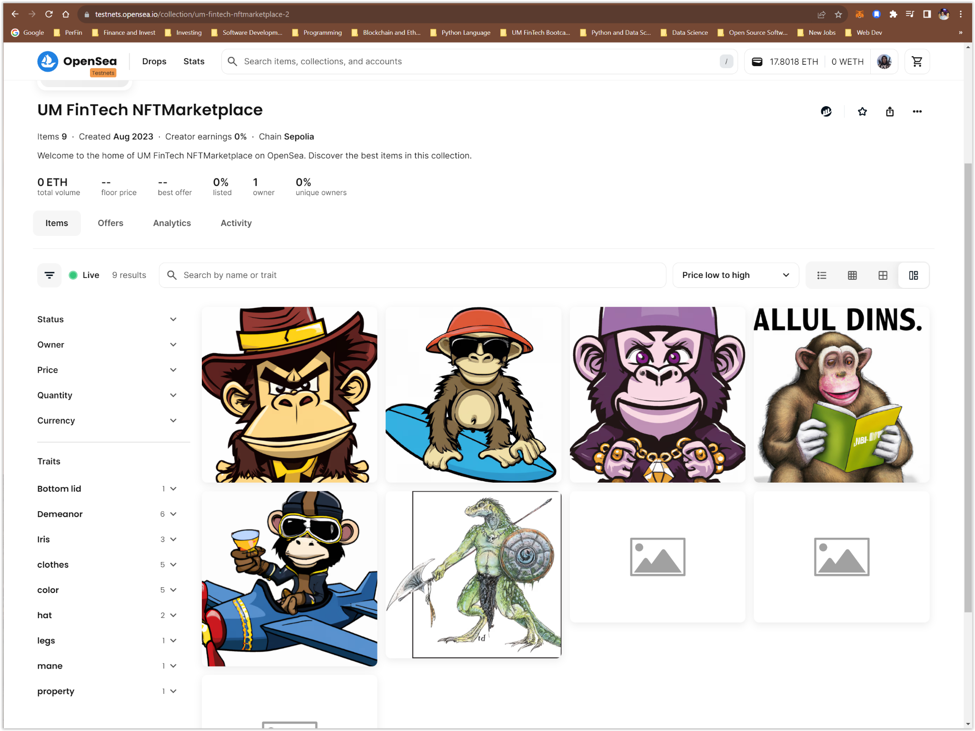
TestNet OpenSea Validation

Slide 9
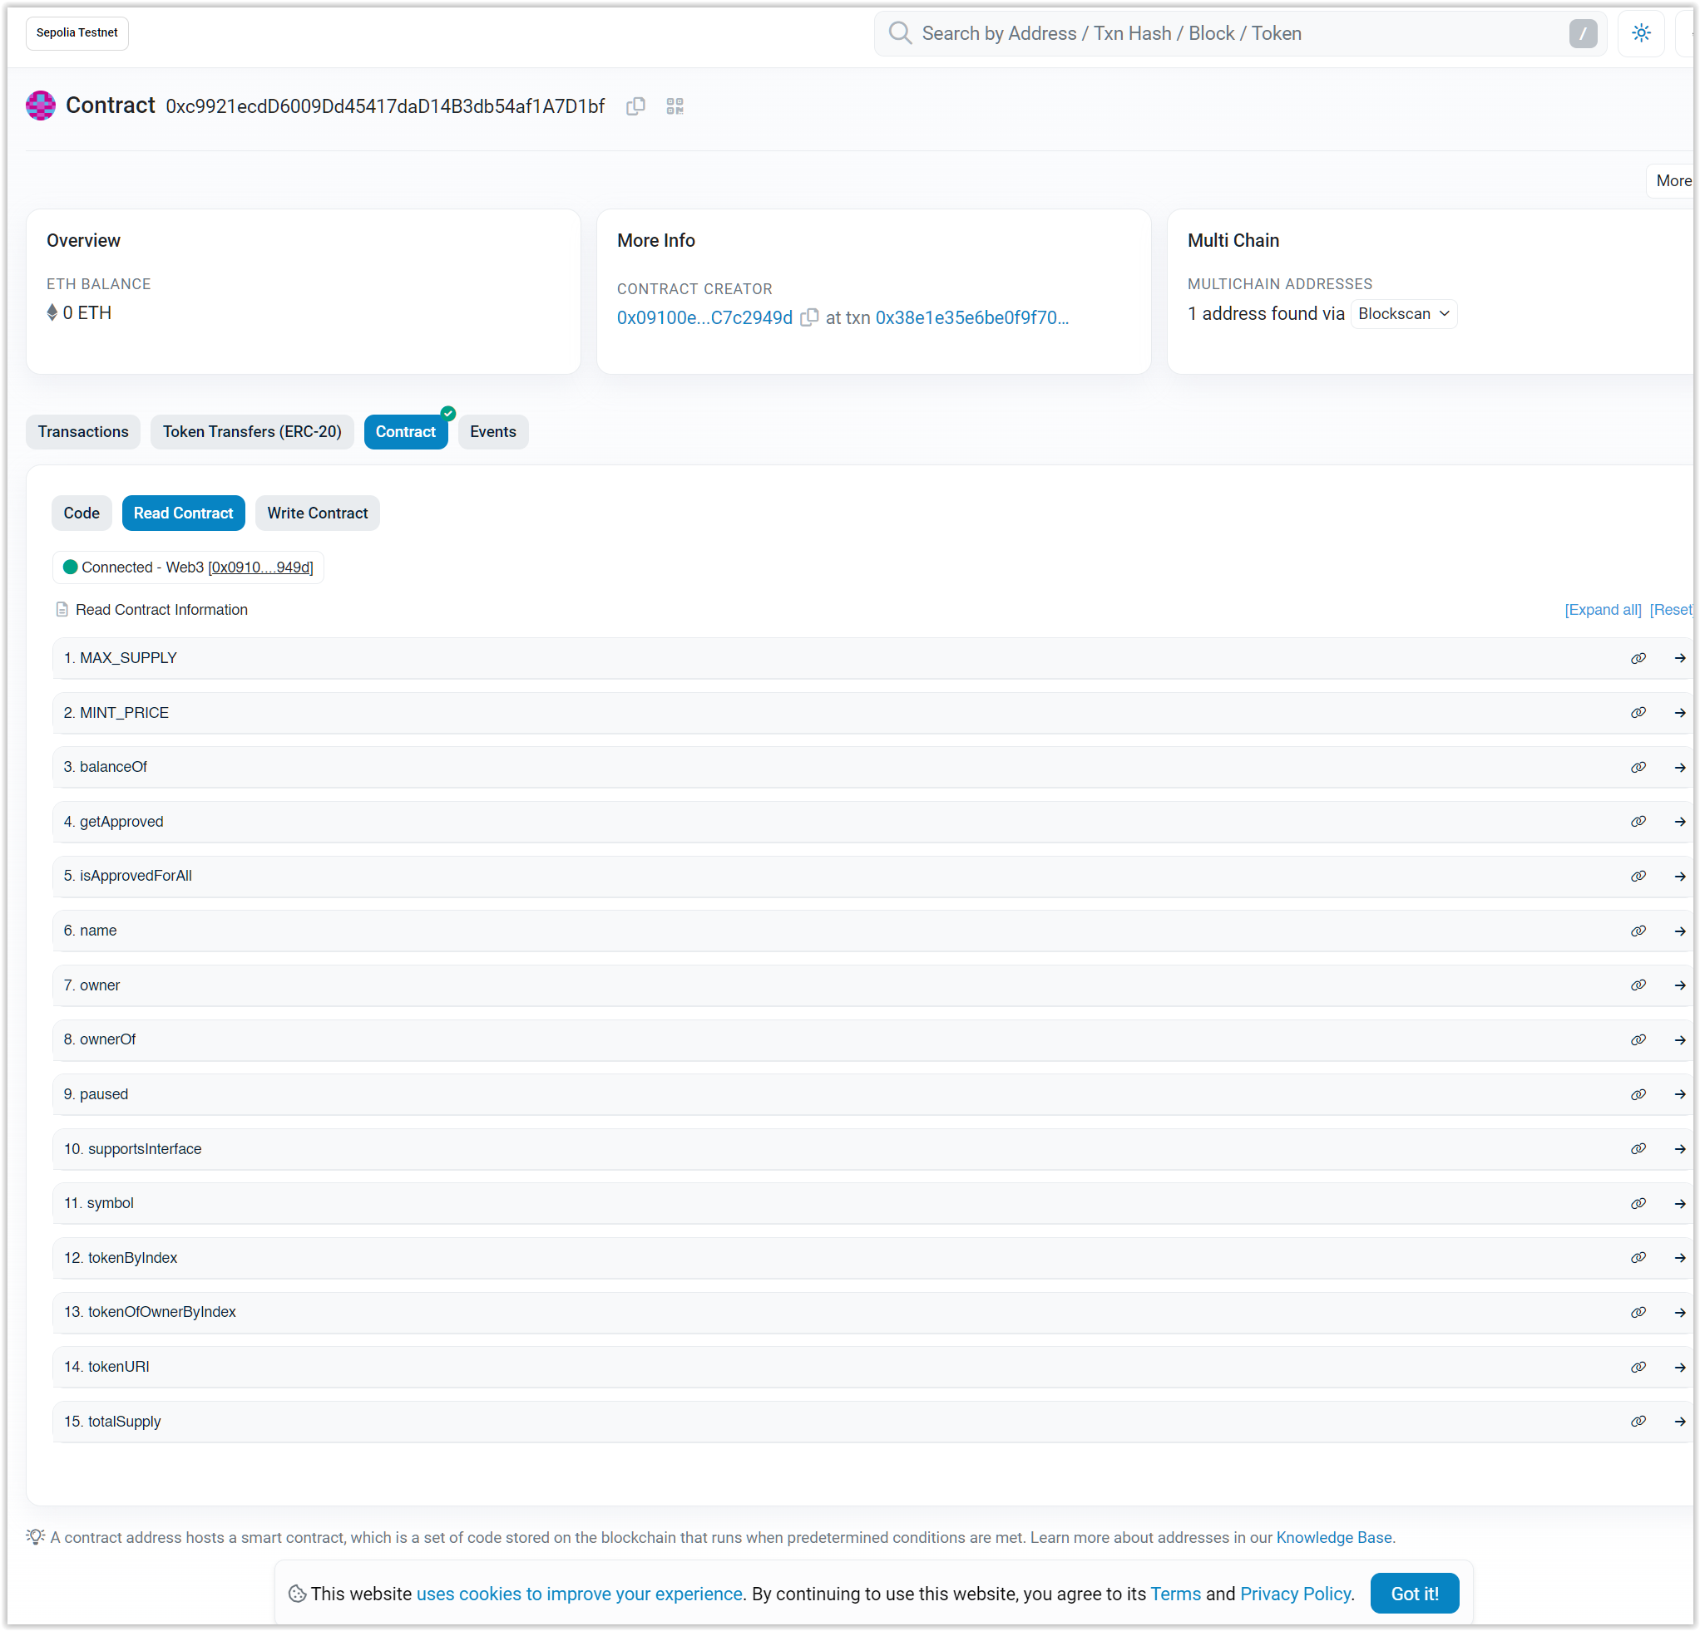
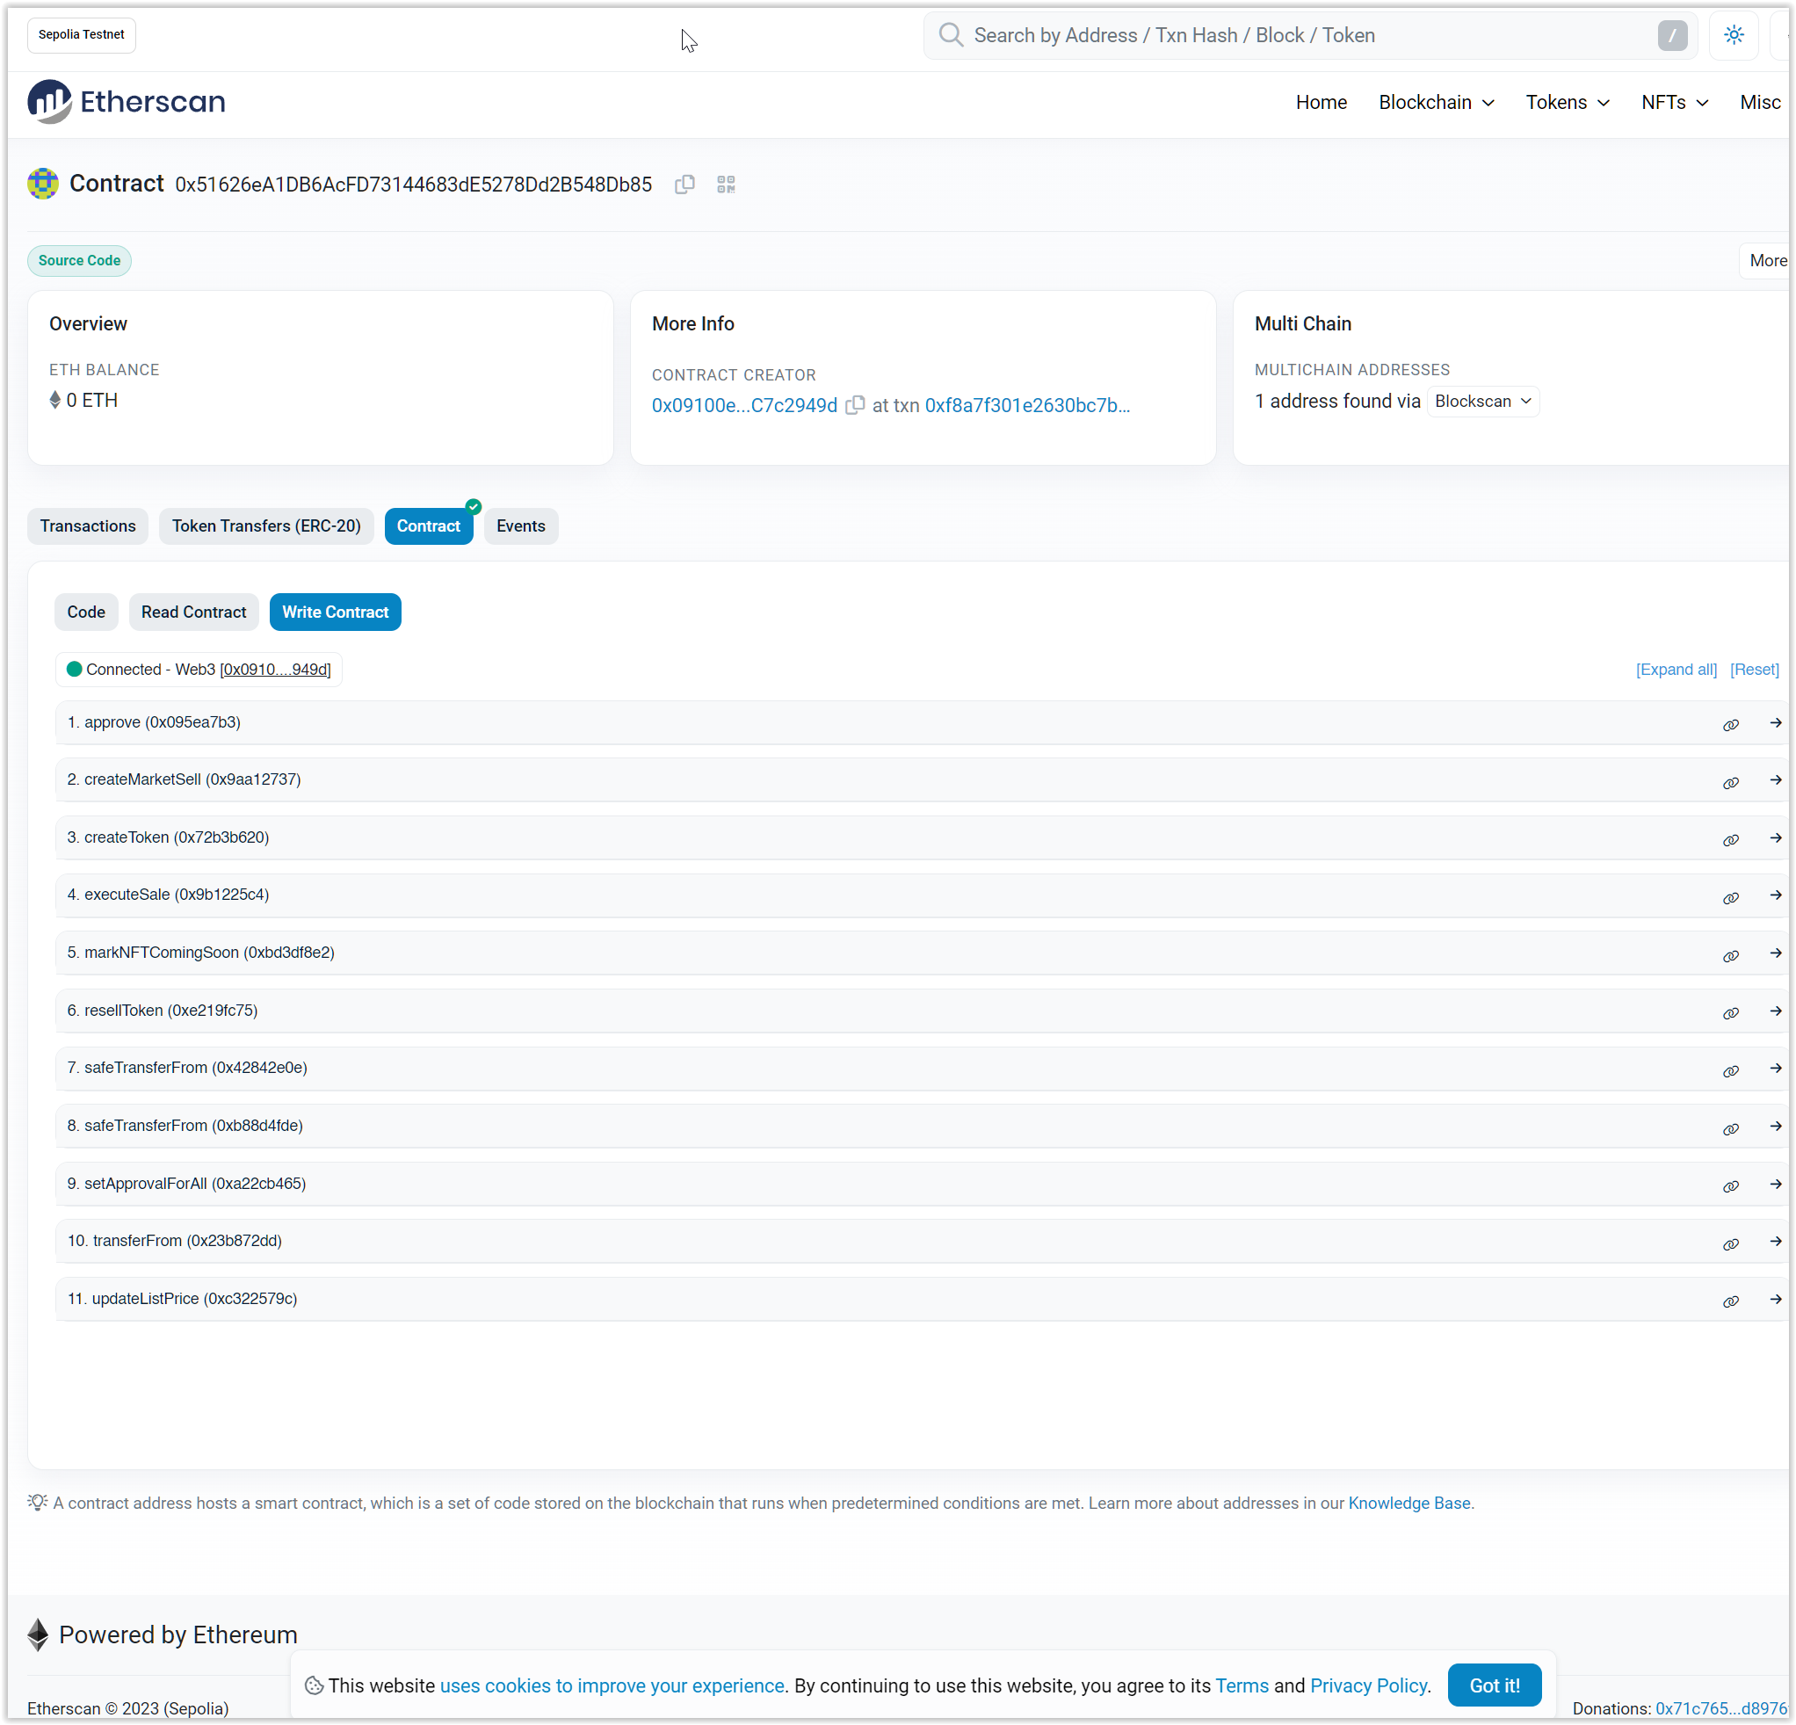
Contract Deployment

Slide 10
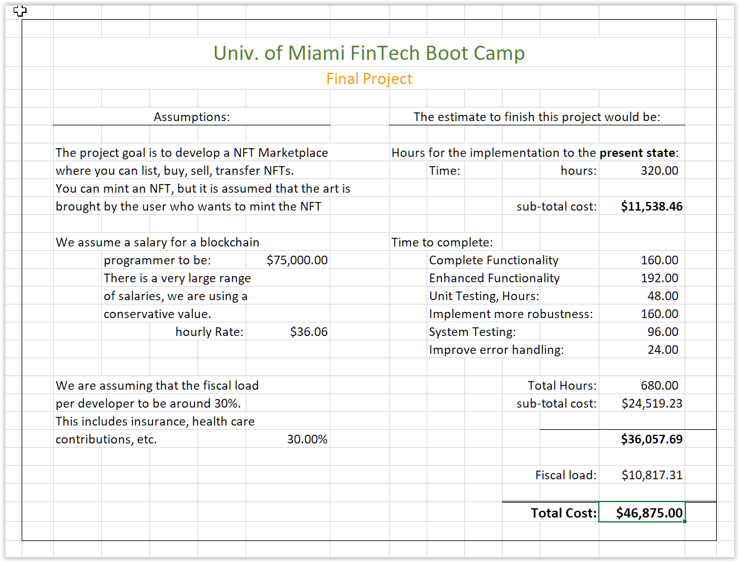
Cost Estimate

Slide 11
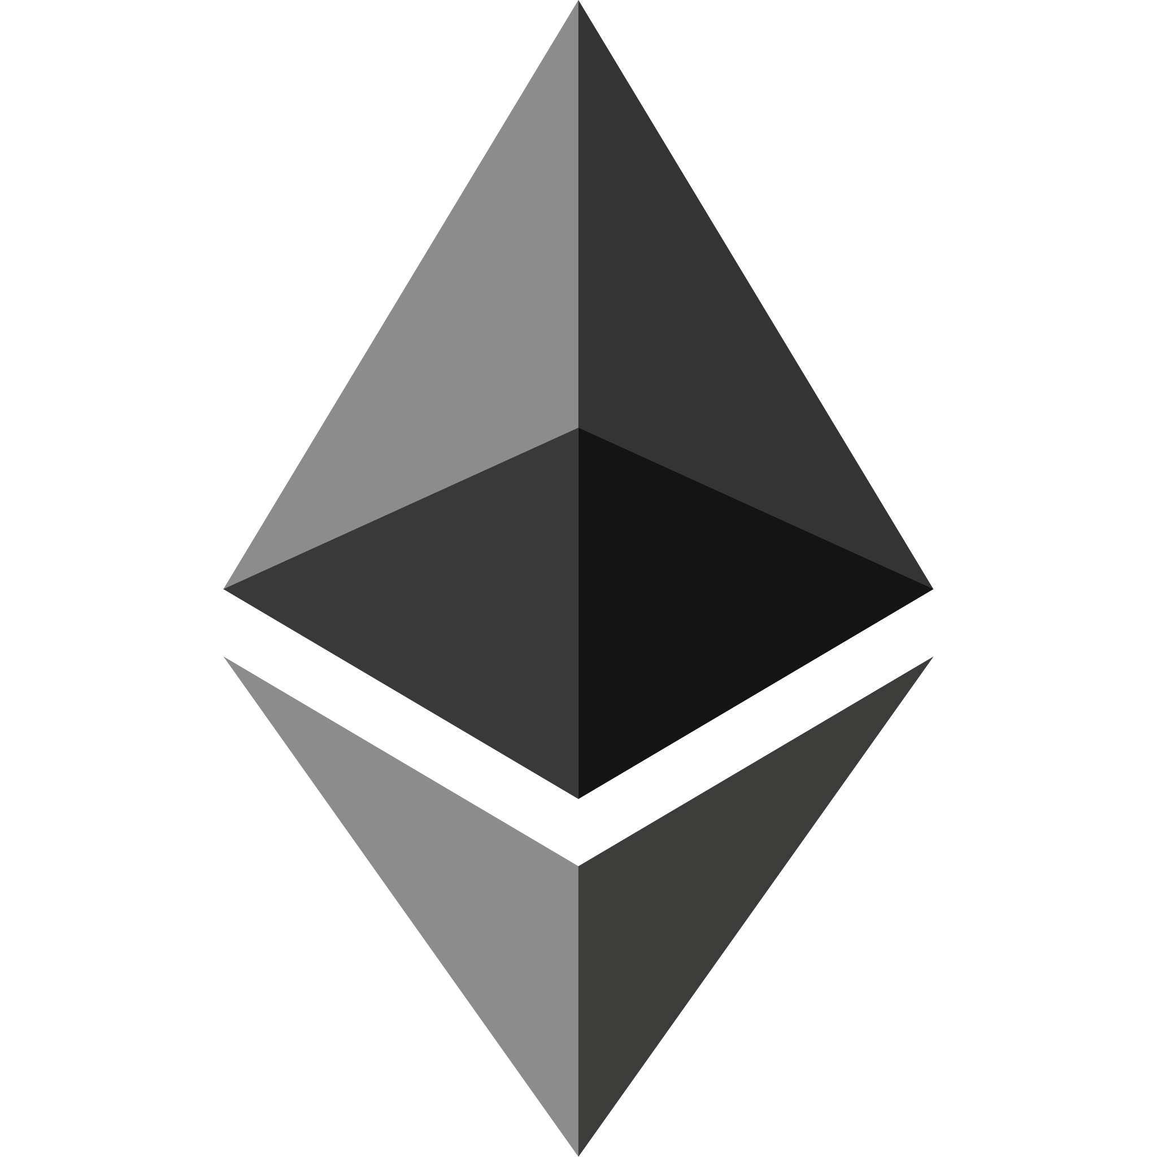
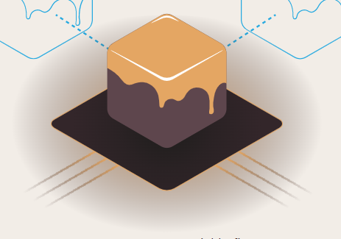


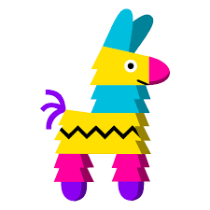


Approach: Technologies Used
Python
Streamlit
Solidity
OpenZeppelin Contracts
Remix
IPFS
Pinata
Ganache
DALLE - 2
Sepolia TestNet
Etherscan.io
OpenSea.io
Python Libraries (pandas, dotenv, Web3, Pathlib, Os, Requests, JSON)

Slide 12
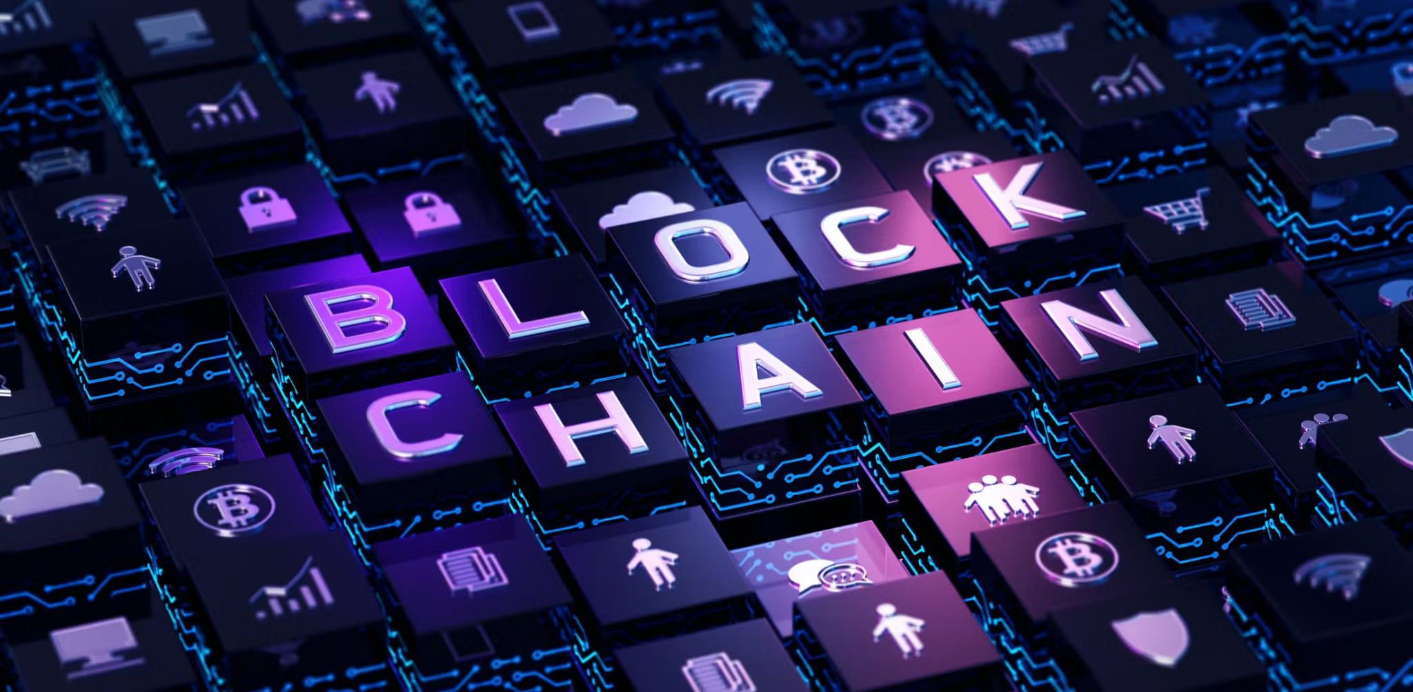
Approach: Breakdown of Tasks and Roles
Comprise various smart contracts using Solidity
ECR 721, defining token, marketplace functionality, meta data ownership, transferability
Marketplace contract - buying, selling, trading, listing, pricing and transactions
Frontend
Creating a pleasant and user friendly experience
IPFS
Store metadata for each NFT
Events and notifications
Security and testing
Deployment
Maintenance and updates
AI Image generation

Slide 13

Challenges
Our team experienced issues establishing communications between the Streamlit python script with the smart contracts once deploy on to the blockchain.
We are unable to send and retrieve integers or small strings but are able to transmit complex data like a NFT contract information to the python script.

Slide 14
Links
https://github.com/Izzlyb/UMFinTech_Project_Final_G2

